Slide 1
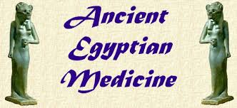
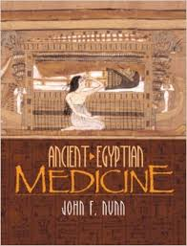
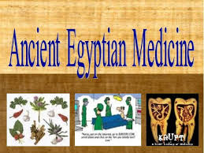
Medicine
Humanities
Period 1
By:
Macii Griego
February
2015

Slide 2
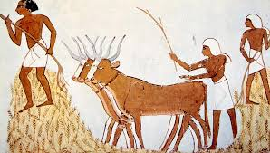
The Use of Medicine in Ancient Egypt
The medicine was made in ancient egypt.
It was used to trade for better goods like wheat and oil.
They carried these things over foot and donkey or cow.

Slide 3
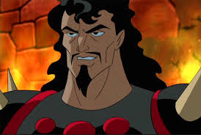
Why they made medicine.
They made a cure for sickness because a lot of people were getting sick.
They also made medicine because they believed that illnesses were caused by evil gods such as Ares and Hades.

Slide 4
What They Used For Medicine
They actually used food and seeds for their medicine. They just either grinded them up and rubbed it on the wound or they ate the food.
Asthma: Garlic
Stomach Aches: Onions
Common Cold: Milk from mother of baby boy
Wound Healing: Honey
Burns: Acacia Seeds
Hair Loss: Henna Seeds
E.T.C

Slide 5
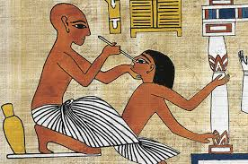
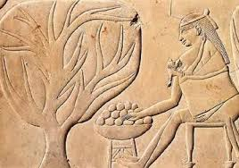
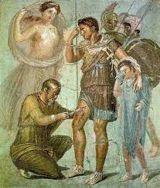
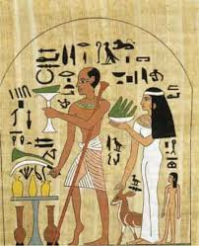
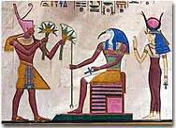
Images

Slide 6
Then v.s. Today
The common cold:
Then- Did not make very sick; cough, headache, and e.t.c.
Now- Did not make major effects; cough, headache, and
e.t.c.
Like the cold, not much have changed in the sicknesses. The only thing that really changed in this situation was the cure for the sickness.

Slide 7
The cost Then v.s. Today
Back then, the medicine was worth wheat and goods for survival instinct and to keep people fed.
Now the medicine is a multi billion dollar market.
V.S.
Then Now

Slide 8
Ingredients
Ingredients: Back in ancient times, the medicine was made up of natural resources. It was made up of plants and food instead of chemical processes like today's medicine is made up of. When you think about it, medicine back then was a lot more healthy than it is today.

Slide 9
Questions
What did ancient egyptians use to transport medicine?
What did ancient egyptians believe illnesses were caused by?
What did ancient egyptians trade for their medicine?
When where the ingredients of the medicine natural and healthy?
What is one sickness? What is the cure?

Slide 10
Bibliography
http://www.reshafim.org.il/ad/egypt/timelines/topics/medicine.htm
http://www.wonderopolis.org
World History Ancient Civilization by McDougal Littell

